Slide 1
Arduino Weather Indicator
Ryan Brock

Slide 2
About Me
Ryan Brock
Software Engineer – 14 Years
Purdue University – Computer Science
Motorola
Zebra Technologies

Slide 3
Contact
Twitter: @borq79
Email: borq79@gmail.com
Github Repo:
https://github.com/borq79/Cary-Area-Public-Library-Classes

Slide 4
Agenda
Review (20 mins)
Arduino
Breadboards
Resistors
LEDs
Capacitors
NeoPixel LED Arrays
Color
Introduction to the Ethernet Shield and Web APIs (30 mins)
Networking Terms
Shield – Getting Connected
HTTP/REST
Getting the Weather Conditions
Projects
Weather Monitor

Slide 5
Arduino Uno

Slide 6
Breadboard

Slide 7
Wiring up a Circuit

Slide 8
Resistors

Slide 9
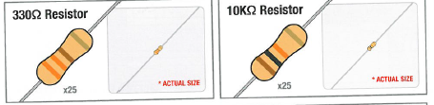
Vilros Kit Resistors
V = IR
I = V / R
I = 5V / 330 = 0.015A (15 mA)
I = 5V / 10,000 = 0.0005A (0.5 mA)

Slide 10
LEDs

Slide 11
Why is one lead longer?

Slide 12
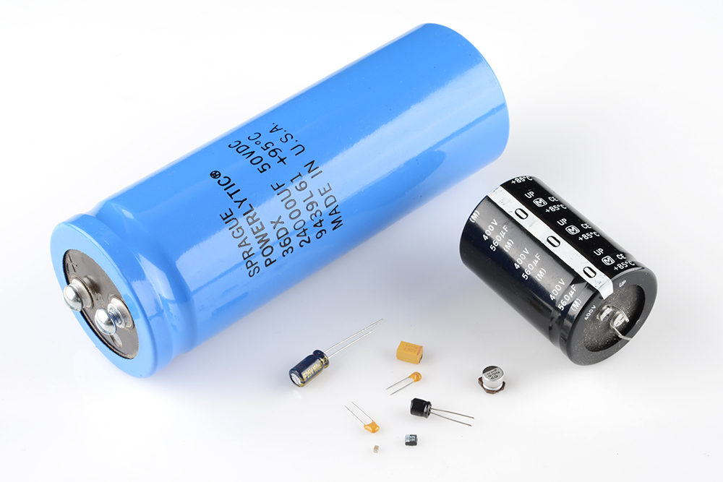
Capacitors

Slide 13
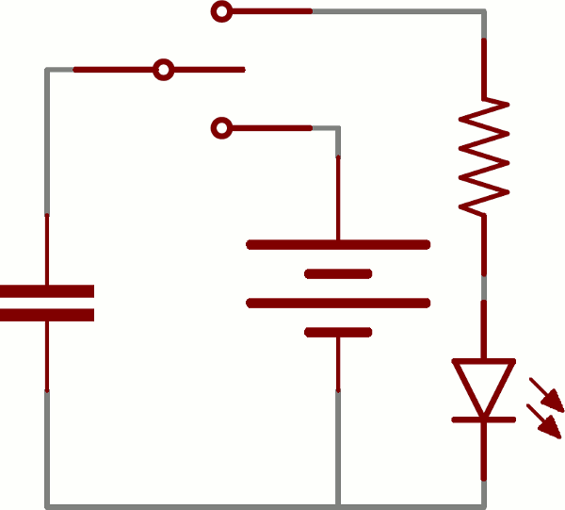
Charging up a Capacitor
Image from: https://learn.sparkfun.com/tutorials/capacitors

Slide 14
Adafruit NeoPixel
The Magic of NeoPixels:
https://learn.adafruit.com/adafruit-neopixel-uberguide/
https://www.youtube.com/watch?time_continue=41&v=HO6xQMR8naw

Slide 15
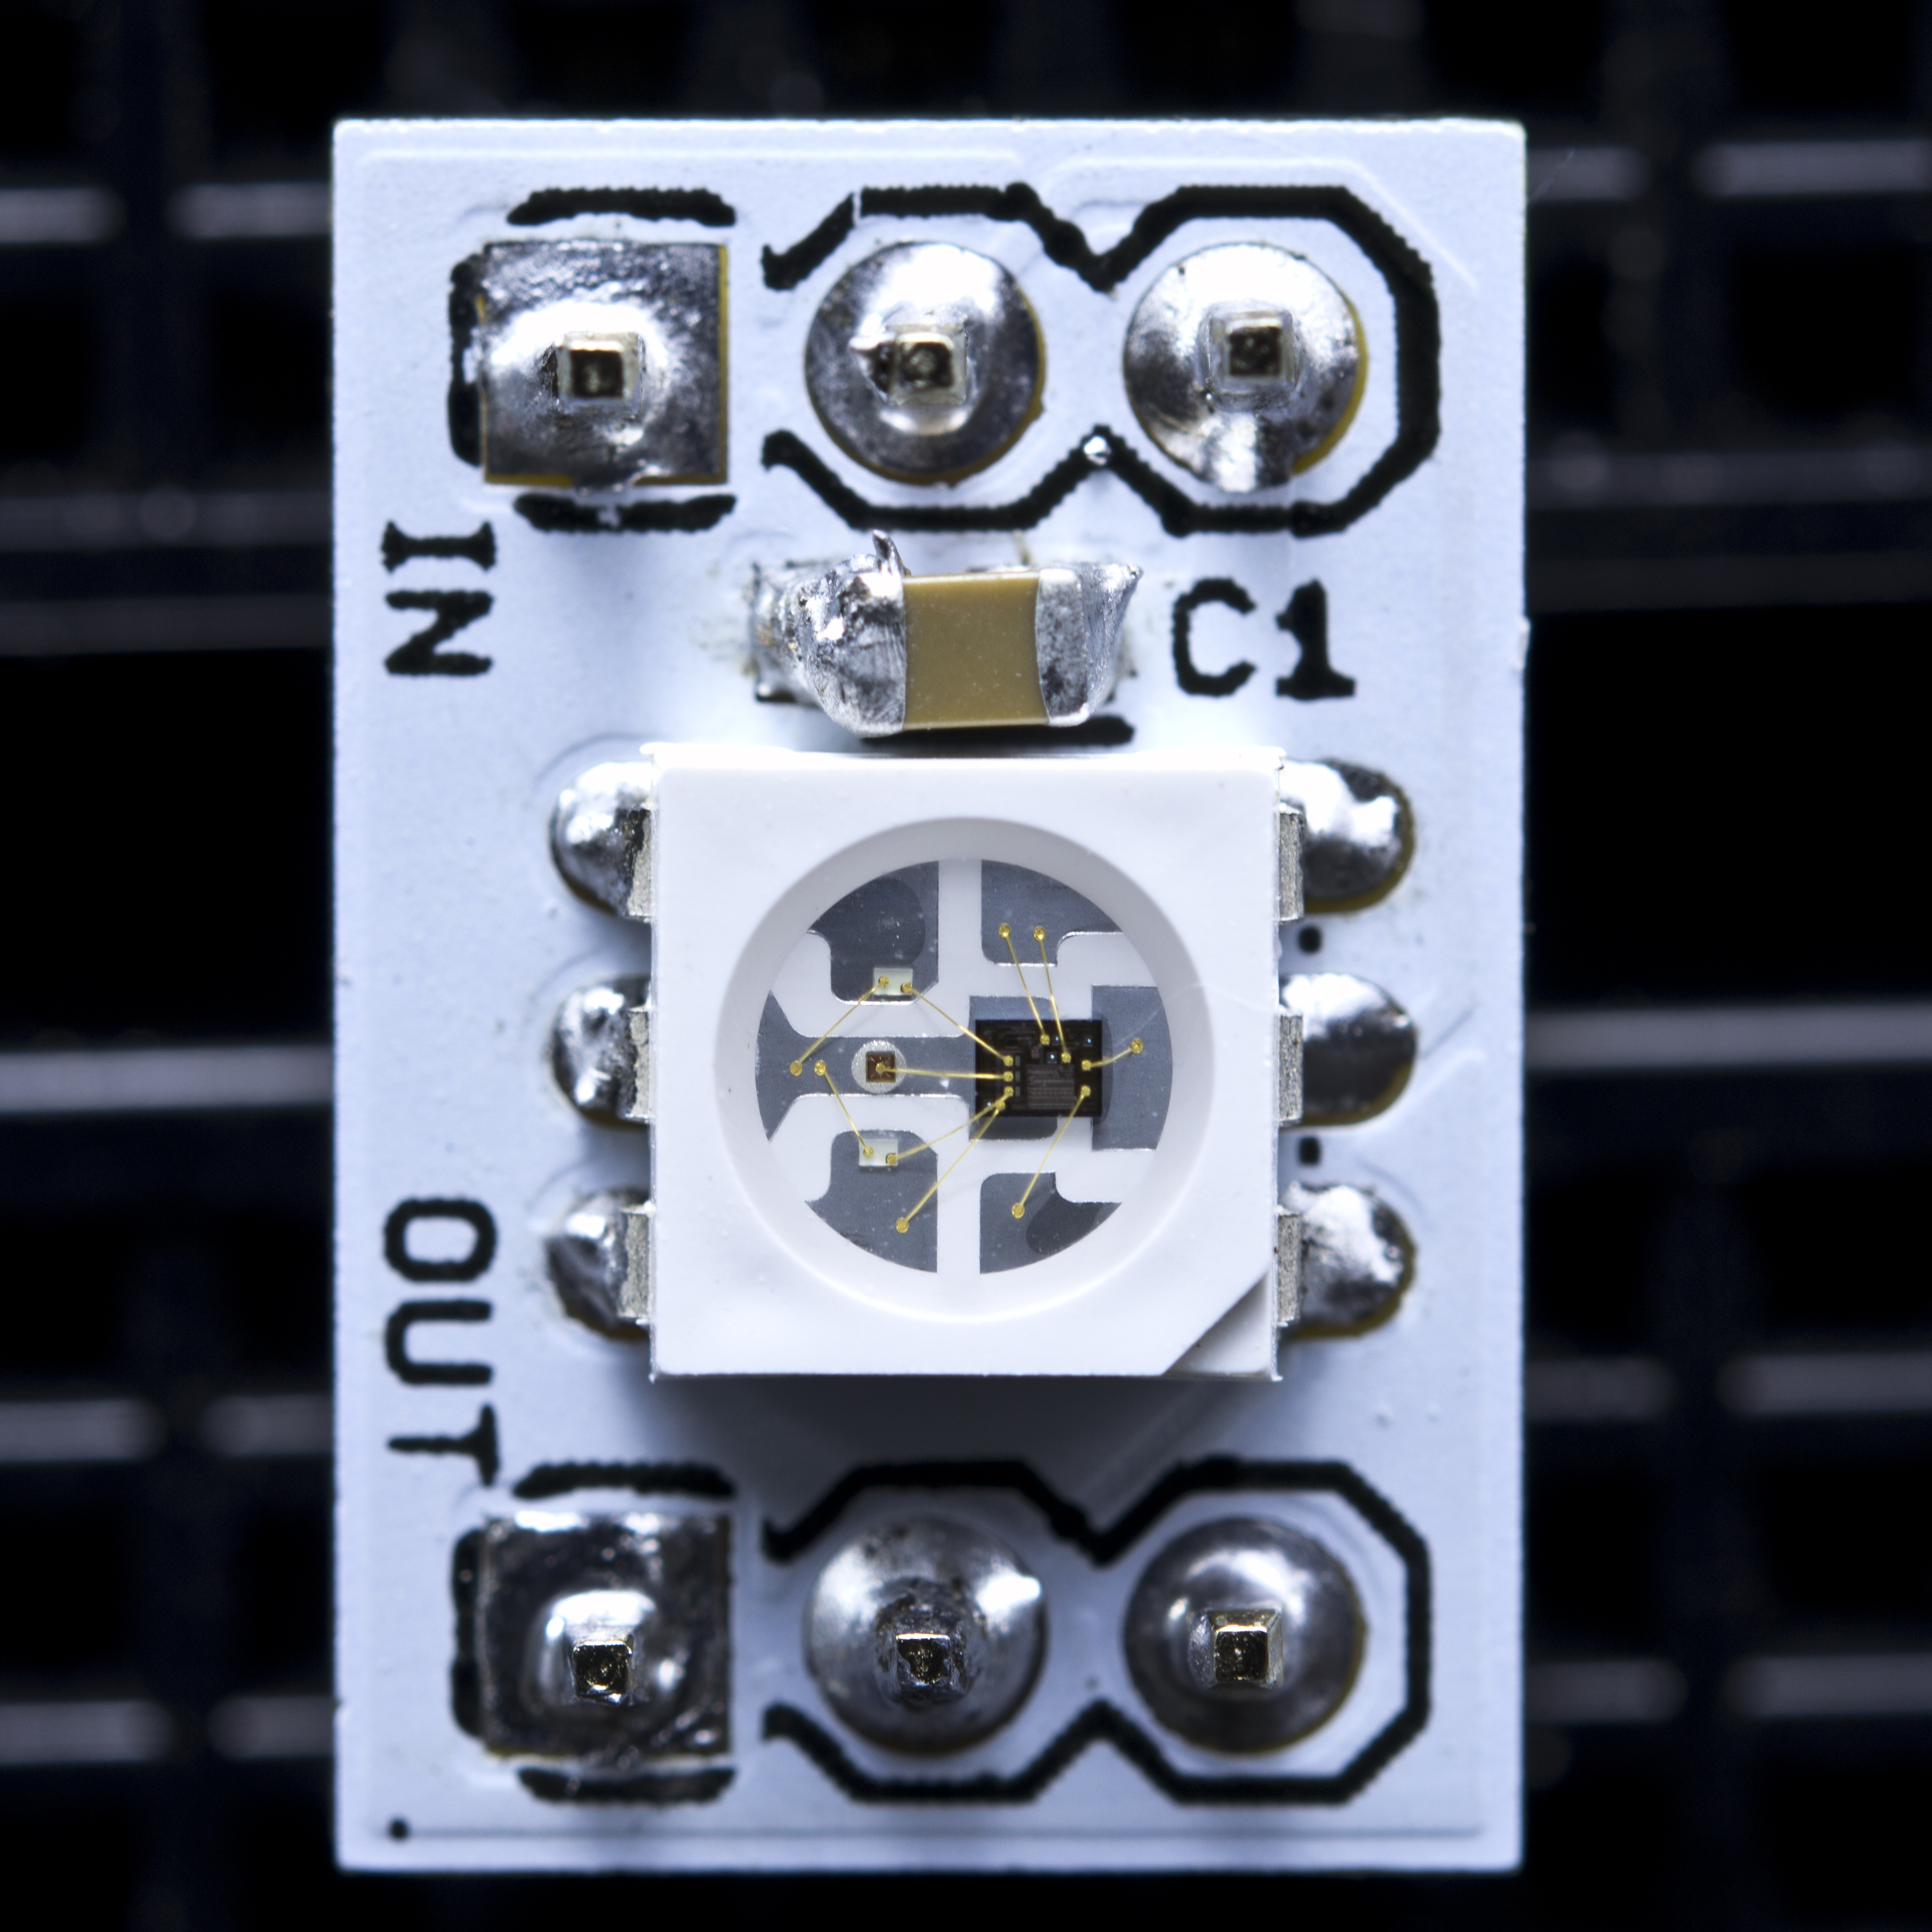
WS2811

Slide 16
WS2811
Datasheet: https://www.adafruit.com/datasheets/WS2811.pdf
A ‘chain’ if 24-bit color sequences
Each pixel’s WS2811 IC will program itself and send the rest of the chain down the line

Slide 17
24, and 32-bit Color
3 LEDs – Red, Blue, and Green
8-bits for each pixel
0 – 255 different brightness levels for each pixel

Slide 18
24, and 32-bit Color
Three colors mix to create 2²⁴ (16,777,216) color combinations, or 24-bit color
32-bit color includes transparency, but ignored for NeoPixels

Slide 19
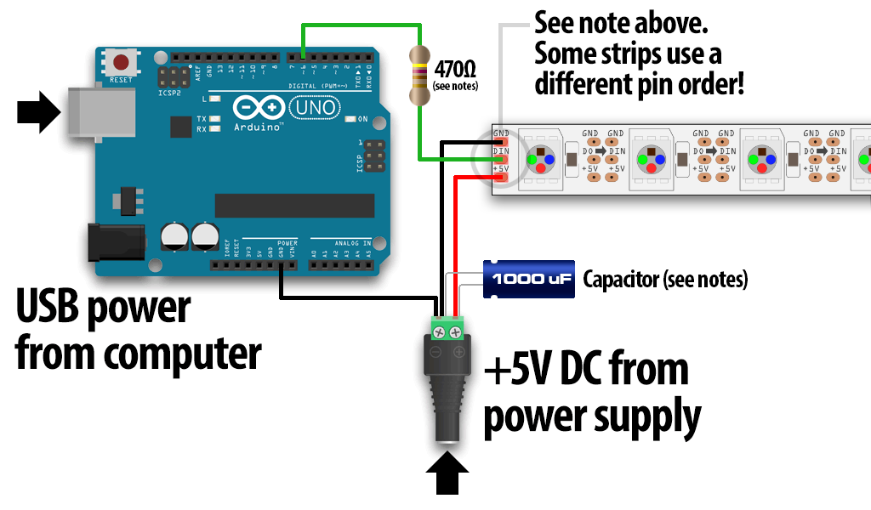
Powering the Strip
Sources: https://learn.adafruit.com/adafruit-neopixel-uberguide/basic-connections

Slide 20
Adafruit NeoPixel Library
Go to: https://learn.adafruit.com/adafruit-neopixel-uberguide/arduino-library-installation
Download the library (big green button)
Uncompress the ZIP file
Create a directory named WS2811 in c:\Program Files\Arduino\Libraries
Copy Adafruit_NeoPixel.cpp and Adafruit_NeoPixel.h
Re-Start the Arduino IDE

Slide 21
Initialization
// Parameter 1 = number of pixels in strip
// Parameter 2 = pin number (most are valid)
// Parameter 3 = pixel type flags, add together as needed:
// NEO_KHZ800 800 KHz bitstream (most NeoPixel products w/WS2812 LEDs)
// NEO_KHZ400 400 KHz (classic 'v1' (not v2) FLORA pixels, WS2811 drivers)
// NEO_GRB Pixels are wired for GRB bitstream (most NeoPixel products)
// NEO_RGB Pixels are wired for RGB bitstream (v1 FLORA pixels, not v2)
Adafruit_NeoPixel strip = Adafruit_NeoPixel(60, PIN, NEO_GRB + NEO_KHZ800);
void setup() {
strip.begin();
strip.show(); // Initialize all pixels to 'off'
}

Slide 22
Set a Pixel’s Color
// Set each color component individually
strip.setPixelColor(n, red, green, blue);
// Set via 32-bit (24-bit) color
strip.setPixelColor(n, color);
// Don’t forget to ’refresh’ the pixel
strip.show();

Slide 23
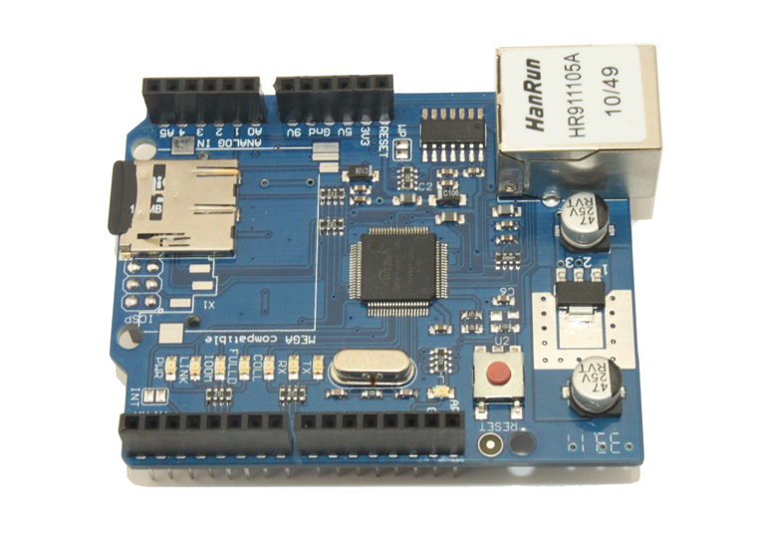
Ethernet Shield
W5100 with internal 16K buffer
Connection speed: 10/100Mb
Onboard SD card slot
Connection with Arduino on SPI port

Slide 24
Some Networking Terms
Ethernet
Protocols
MAC Address
TCP, UDP, IP
DHCP vs. Static
Port (80, 443)
Ping
HTTP

Slide 25
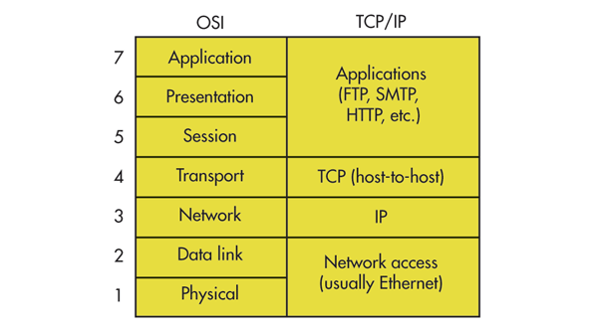
Networking OSI Model

Slide 26
Connect to a Network
https://www.arduino.cc/en/Tutorial/WebClient
// Ethernet Shield Information
#define ETHERNET_SHIELD_MAC {0xDE, 0xAD, 0xBE, 0xEF, 0x00, 0x00}
byte ethernetMACAddress[] = ETHERNET_SHIELD_MAC;
EthernetClient client;
// Initialize the shield
Ethernet.begin(ethernetMACAddress);
// print out the IP address
Serial.print("IP = "); Serial.println(Ethernet.localIP());
// Connect to the server
client.connect("www.google.com", 80);
// Send the HTTP request to get the HTML response
client.println("GET /search?q=arduino HTTP/1.1"); client.println("Host: www.google.com"); client.println("Connection: close");
// While data is available, read the response and print it out
if (client.available()) { char c = client.read(); Serial.print(c); }
// Finish
client.stop();

Slide 27
HTTP / REST / JSON / XML
HTTP (Hypertext Transfer Protocol)
GET / POST / PUT / DELETE
200, 404, 500
API (Application Programming Interface)
ReST (Representational State Transfer)
Send HTTP request
HTML, JSON, XML response

Slide 28
HTTP / REST / JSON / XML
HTTP GET Example – Search Google
GET /search?q=arduino HTTP/1.1 Host: www.google.com Connection: close
\r\n
Response 200 OK

Slide 29
HTML
<html>
<head>
<title> response </title> </head>
<body>
A = 1 <br/>
B = 2 <br/>
C = 3 <br/>
</body>
</html>

Slide 30
JSON
{
“A”: “1”,
“B”: “2”,
”C”: “3”
}

Slide 31
XML
<xml>
<document>
<items>
<item name=“A”>1</item>
<item name=“B”>2</item>
<item name=“C”>3</item>
</items>
</document>
</xml>

Slide 32
Get the Weather
‘Screen Scrape’ weather.com
Weather Underground API
Temboo Reduced Response API

Slide 33
Temboo
Code Generation
Easy API
Library Provided
Sign up for an account to get a development key
https://temboo.com/library/Library/Yahoo/Weather/GetWeatherByAddress/
Yahoo Weather Conditions
https://gist.github.com/bzerangue/805520

Slide 34
Project Parts List
Arduino
Breadboard
USB Cable
Ethernet Shield
Ethernet Cable (provided by Ryan)
1 Neo Pixel Strip with 8 LEDs
1 1000F Capacitor (provided by Ryan)
1 10K Ohm resistor (in kit)
3 Male-Female wires (provided by Ryan)
3 Male-Male wires (in kit)

Slide 35
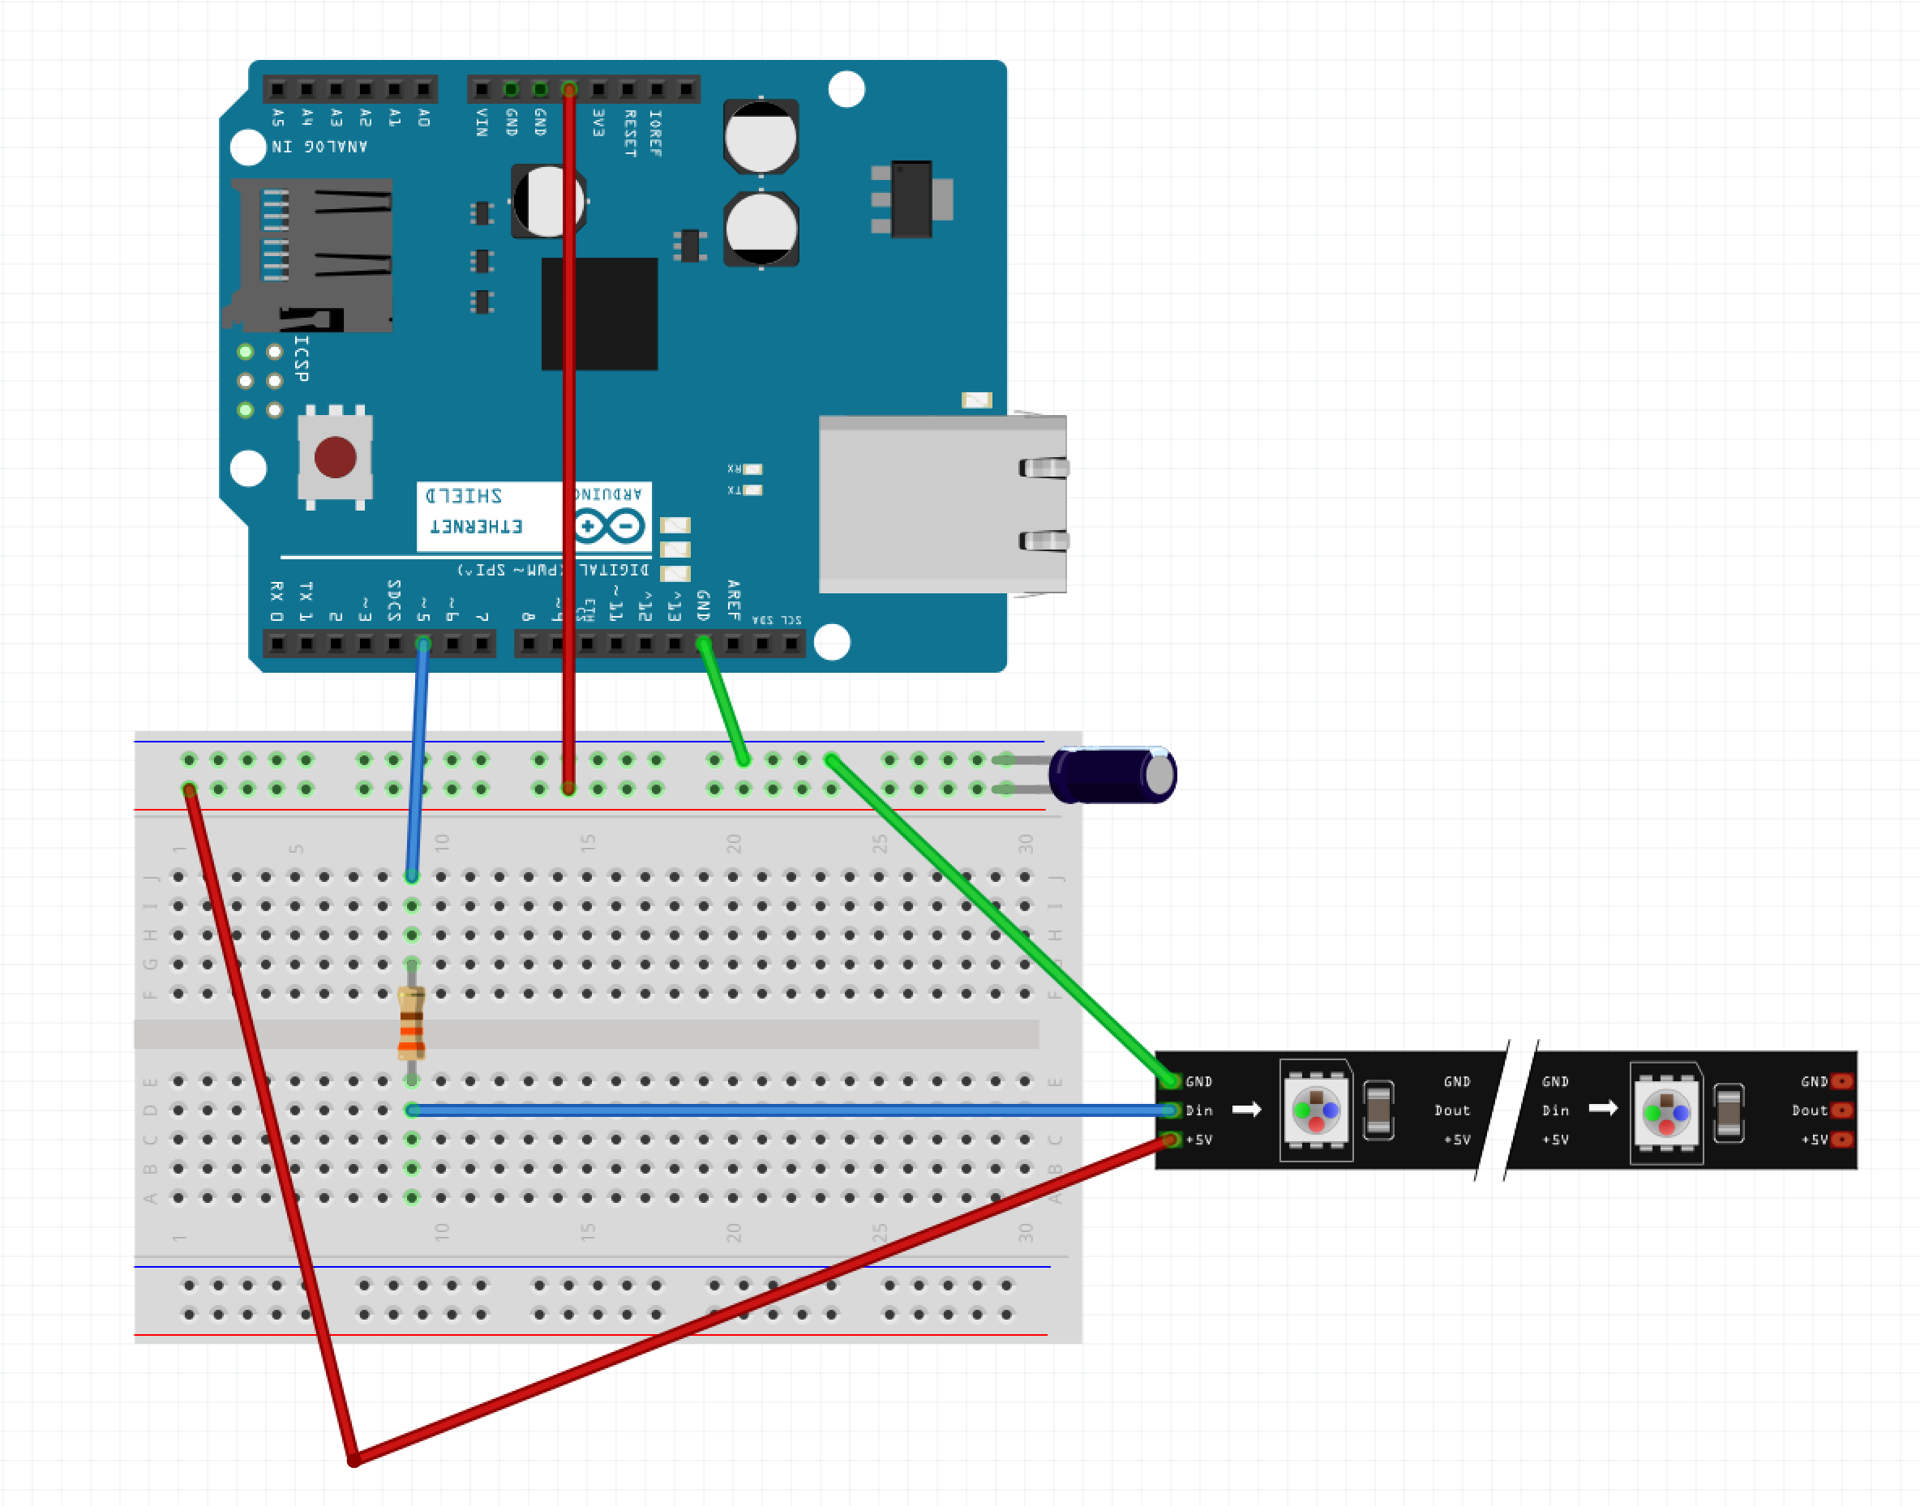
Project Wiring Diagram

Slide 36
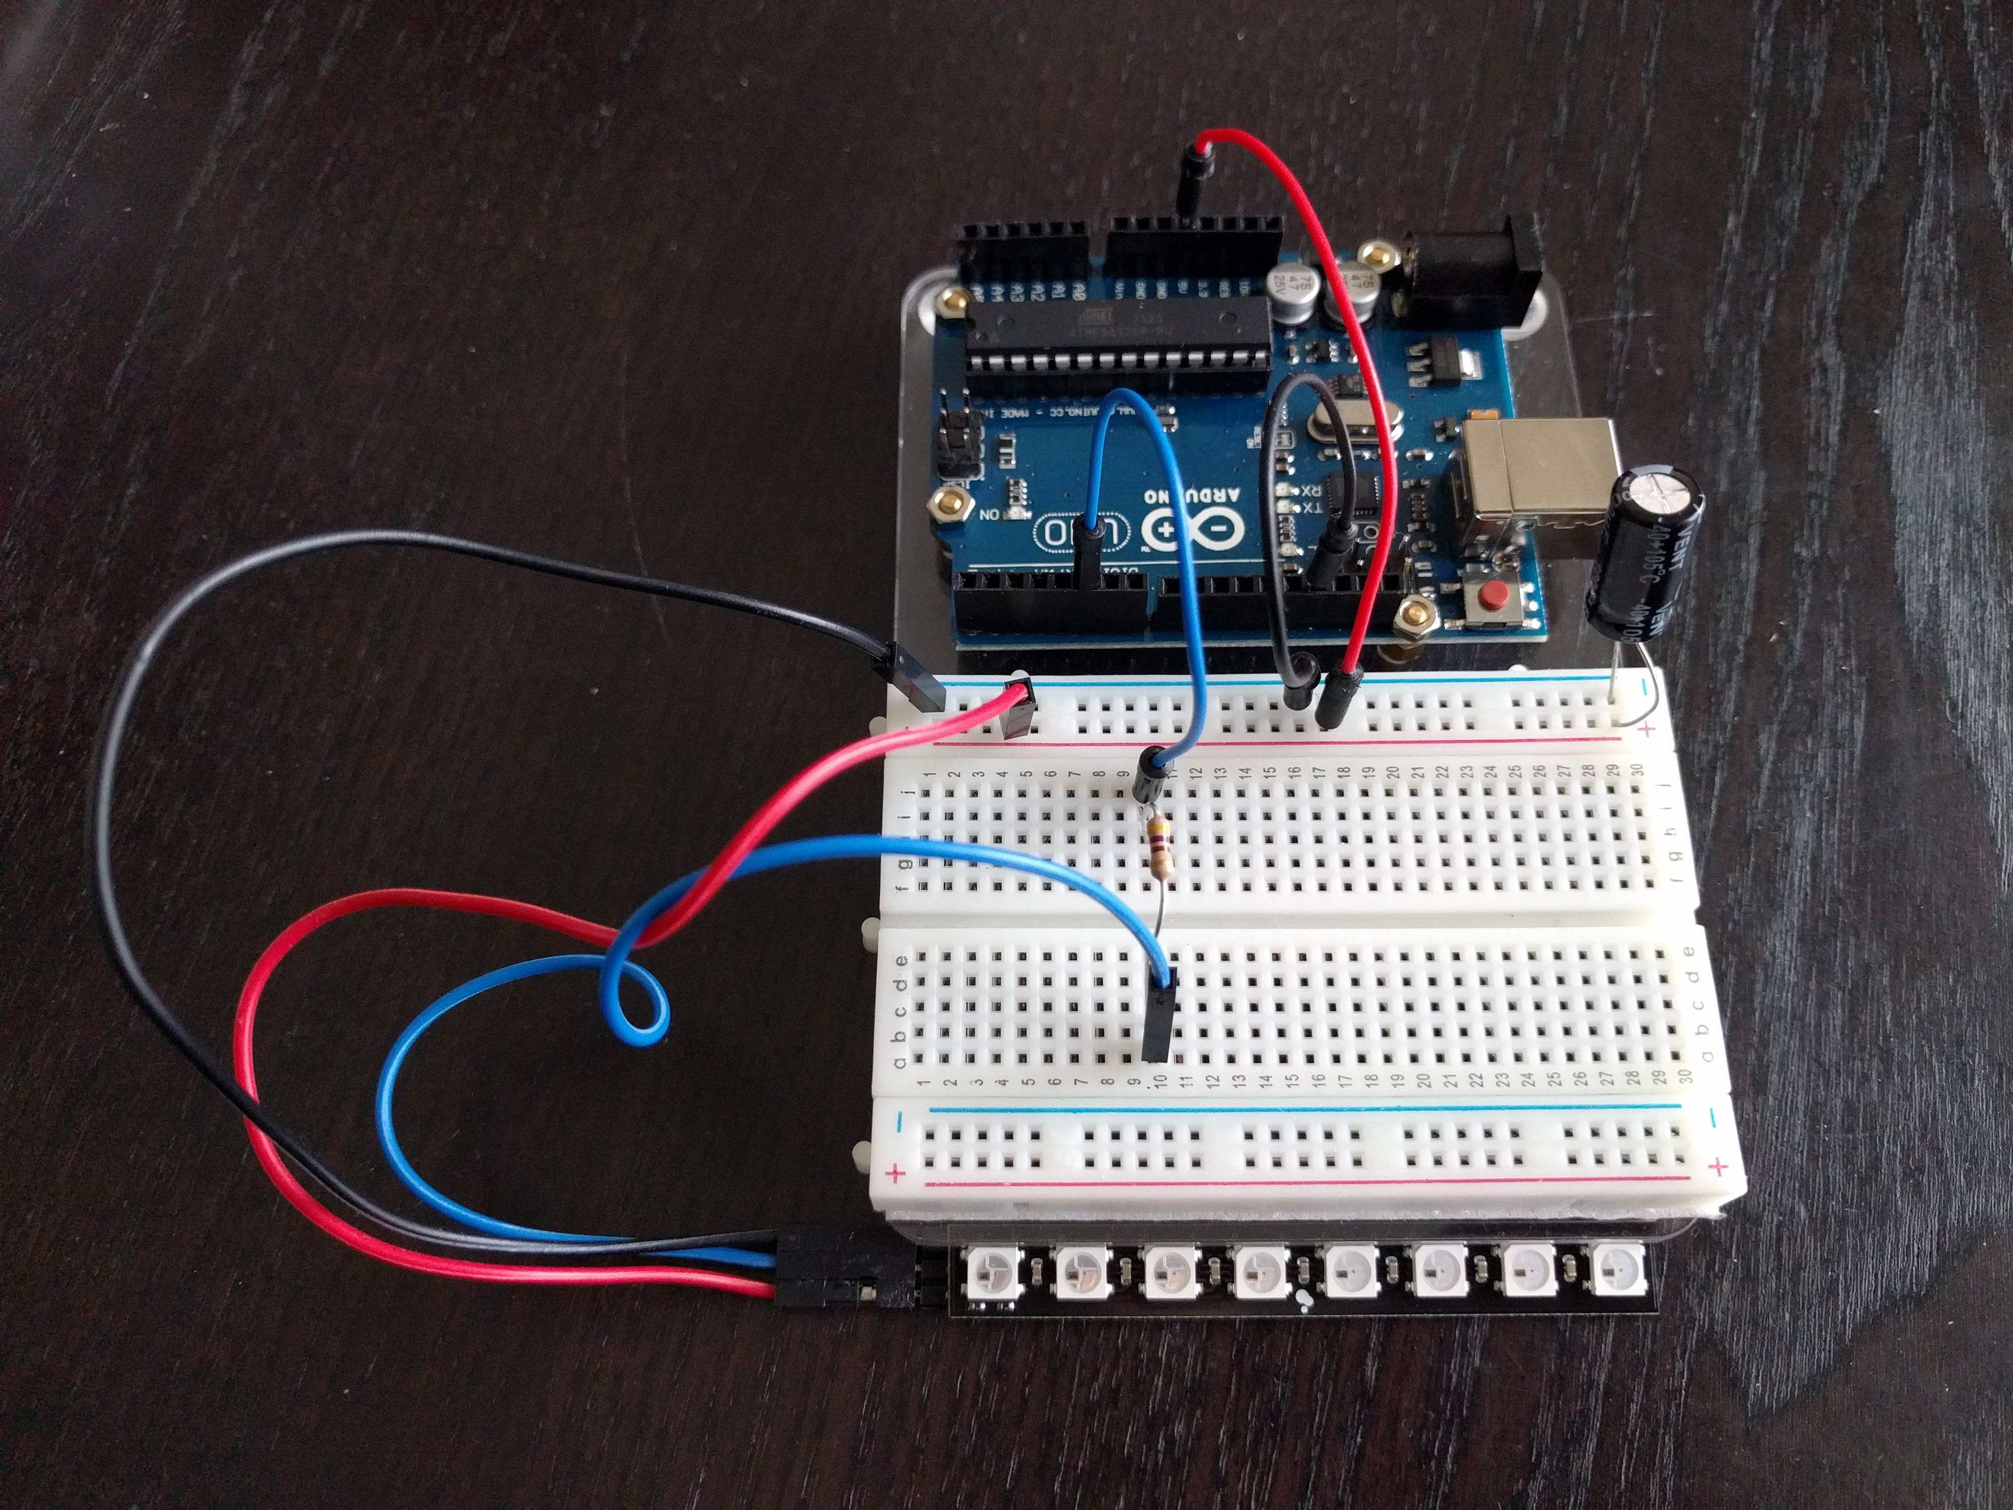
Project Wiring Photo

Slide 37
Project One Code
https://github.com/borq79/Cary-Area-Public-Library-Classes
weather
weather_meter
weather_meter.ino

